Slide 1
The Pochoir Stencil Generator
Yuan Tang, Charles E. Leiserson, Bradley C. Kuszmaul, C. K. Luk, Will Hansplaugh, Rezaul Alam Chowdhury

Slide 2
Background
For a given point, a stencil is a fixed subset of near neighbors.
A stencil code updates every point in an n-dimensional spatial grid at time t as a function of nearby grid points at times t–1, t-2, …, t–k.
Stencils are used in iterative PDE solvers such as Jacobi, Multi-grid, and AMR, as well as for image processing and geometric modeling.
x+1
z+1
y+1
y-1
(x,y,z)
z-1
x-1
3D regular grid
3D 7-point stencil
2
Notes:
Stencils are critical to many applications (e.g. diffusion, electromagnetics, image processing)

Slide 3
Looping Implementation
A nested loop implementation is straightforward:
for (t = 1; t≤T, ++t) {
for (i0 = 0, i0<n0, ++i0) {
for (i1 = 0, i1<n1, ++i1) {
for (i2 = 0, i2<n2, ++i2) {
⟨⟨ update A[t%k,i0,i1,i2] according to stencil ⟩⟩
} } } }
Issue: Looping is memory intensive, especially for parallel implementations, and it uses caches poorly.

Slide 4
Cache-Oblivious Algorithms
t
x
Divide-and-conquer cache-oblivious techniques, based on trapazoidal decompositions, are known to be effective.
Problem: These codes are difficult to write.

Slide 5
Pochoir Stencil Generator
The stencil specification separates the stencil mathematics from the algorithm used to divide and conquer the computing domain.
The generated stencil code uses efficient cache-oblivious algorithms based on divide-and-conquer.
The stencil computation is parallelized using the Intel Cilk Plus technology.

Slide 6
Executable Specification
The stencil specification can be executed and tested for correctness without Pochoir using a C++ template library.
The specification supports arbitrary D-dimensional rectangular grids, where D is a compile-time constant.
The stencil shape can be arbitrary.
A point at time t can depend on points at time t–1, t–2, …, t–k, where k is a compile-time constant.
Both periodic and nonperiodic boundary conditions are supported.

Slide 7
2D Heat Equation: Ideal Specification
Pochoir<2> heat;
Pochoir_Array<double, 2> a(N_SIZE, M_SIZE);
Pochoir_Shape<2> shape[6] = {{0, 0, 0}, {-1, 1, 0}, {-1, 0, 0}, {-1, -1, 0}, {-1, 0, -1}, {-1, 0, 1}};
Pochoir_Boundary_2D(bdry, arr, t, i, j)
if (i <= 0 || i >= arr.size(1)-1 || j < =0 || j >= arr.size(0)-1)
return 0;
else
return arr.get(t, i, j);
Pochoir_Boundary_end
Pochoir_kernel_2D(kern, t, i, j)
a(t, i, j) = 0.125 * (a(t-1, i+1, j) - 2.0 * a(t-1, i, j) + a(t-1, i-1, j)) + 0.125 * (a(t-1, i, j+1) - 2.0 * a(t-1, i, j) + a(t-1, i, j-1)) + a(t-1, i, j);1)) + a(t-1, i, j);
Pochoir_kernel_end
for (int i = 0; i < N_SIZE; ++i) {
for (int j = 0; j < N_SIZE; ++j) {
a(0, i, j) = rand();
}}
heat.registerBoundaryFn(a, bdry);
heat.registerShape(shape);
heat.registerKernel(kern);
heat.run(T);
Order does not matter as long as antecedents are satisfied (e.g., don’t register something until after it has been defined).
Define
Initialize
Register
Run

Slide 8
Bug in Intel Compiler
The Intel compiler for Linux contains a bug that does not allow function objects to capture lambda functions.
The Intel compiler for Windows supports this functionality, as does gcc for Linux.
Since we do most of our development under Linux, our current specification syntax is somewhat more clumsy and restricted.

Slide 9
2D Heat Equation: Current Specification
Pochoir<2> heat;
Pochoir_Array<double, 2> a(N_SIZE, M_SIZE);
Pochoir_Shape<2> shape[6] = {{0, 0, 0}, {-1, 1, 0}, {-1, 0, 0}, {-1, -1, 0}, {-1, 0, -1}, {-1, 0, 1}};
Pochoir_Boundary_2D(bdry, arr, t, i, j)
if (i <= 0 || i >= arr.size(1)-1 || j < =0 || j >= arr.size(0)-1)
return 0;
else
return arr.get(t, i, j);
Pochoir_Boundary_end
Pochoir_kernel_2D(kern, t, i, j)
a(t, i, j) = 0.125 * (a(t-1, i+1, j) - 2.0 * a(t-1, i, j) + a(t-1, i-1, j)) + 0.125 * (a(t-1, i, j+1) - 2.0 * a(t-1, i, j) + a(t-1, i, j-1)) + a(t-1, i, j);1)) + a(t-1, i, j);
Pochoir_kernel_end
for (int i = 0; i < N_SIZE; ++i) {
for (int j = 0; j < N_SIZE; ++j) {
a(0, i, j) = rand();
}}
heat.registerBoundaryFn(a, bdry);
heat.registerShape(shape);
heat.run(T, kern);
Define
Initialize
Register
Run

Slide 10
Declare a Stencil Computation
Pochoir<2> heat;
Pochoir_Array<double, 2> a(N_SIZE, M_SIZE);
Pochoir_Shape<2> shape[6] = {{0, 0, 0}, {-1, 1, 0}, {-1, 0, 0}, {-1, -1, 0}, {-1, 0, -1}, {-1, 0, 1}};
Pochoir_Boundary_2D(bdry, arr, t, i, j)
if (i <= 0 || i >= arr.size(1)-1 || j < =0 || j >= arr.size(0)-1)
return 0;
else
return arr.get(t, i, j);
Pochoir_Boundary_end
Pochoir_kernel_2D(kern, t, i, j)
a(t, i, j) = 0.125 * (a(t-1, i+1, j) - 2.0 * a(t-1, i, j) + a(t-1, i-1, j)) + 0.125 * (a(t-1, i, j+1) - 2.0 * a(t-1, i, j) + a(t-1, i, j-1)) + a(t-1, i, j);1)) + a(t-1, i, j);
Pochoir_kernel_end
for (int i = 0; i < N_SIZE; ++i) {
for (int j = 0; j < N_SIZE; ++j) {
a(0, i, j) = rand();
}}
heat.registerBoundaryFn(a, bdry);
heat.registerShape(shape);
heat.run(T, kern);
Pochoir < type, dim, toggle> name;
type is the type of the arrays used by the stencil computation.
dim is the number of spatial dimensions.
toggle is the number of internal toggle array.
name is the name of the stencil object.
Declare a Pochoir Stencil object name, which is of type type and rank dim
Current restriction: all arrays must have the same type.
Notes:
It seems that the syntax should be updated.
“toggle” is not defined

Slide 11
Array Declaration
Pochoir<2> heat;
Pochoir_Array<double, 2> a(N_SIZE, M_SIZE);
Pochoir_Shape<2> shape[6] = {{0, 0, 0}, {-1, 1, 0}, {-1, 0, 0}, {-1, -1, 0}, {-1, 0, -1}, {-1, 0, 1}};
Pochoir_Boundary_2D(bdry, arr, t, i, j)
if (i <= 0 || i >= arr.size(1)-1 || j < =0 || j >= arr.size(0)-1)
return 0;
else
return arr.get(t, i, j);
Pochoir_Boundary_end
Pochoir_kernel_2D(kern, t, i, j)
a(t, i, j) = 0.125 * (a(t-1, i+1, j) - 2.0 * a(t-1, i, j) + a(t-1, i-1, j)) + 0.125 * (a(t-1, i, j+1) - 2.0 * a(t-1, i, j) + a(t-1, i, j-1)) + a(t-1, i, j);1)) + a(t-1, i, j);
Pochoir_kernel_end
for (int i = 0; i < N_SIZE; ++i) {
for (int j = 0; j < N_SIZE; ++j) {
a(0, i, j) = rand();
}}
heat.registerBoundaryFn(a, bdry);
heat.registerShape(shape);
heat.run(T, kern);
Pochoir_Array< type, dim, toggle> name(size_{dim–1}, …, size₁, size₀);
type is the type of the stencil array
dim is the number of dimensions
toggle is the number of internal toggle array
name is the name of array
size_{dim}, …, size₁, size₀ are the sizes of each spatial dimension
Declare a Pochoir_Array object name, which is of type type and rank dim, where the spatial dimensions are size_{dim–1} × … × size₁ × size₀.
The class Pochoir_Array contains both underlying storage and corresponding operating methods.
Notes:
The semantic specification should describe the generic, not the specific example. I’ve fixed it here, but you need to do the same on all the slides.
The semantics of “toggle” is not specified or used in the example. (Why can’t this be inferred from shape?)

Slide 12
Stencil Declaration
Pochoir<2> heat;
Pochoir_Array<double, 2> a(N_SIZE, M_SIZE);
Pochoir_Shape<2> shape[6] = {{0, 0, 0}, {-1, 1, 0}, {-1, 0, 0}, {-1, -1, 0}, {-1, 0, -1}, {-1, 0, 1}};
Pochoir_Boundary_2D(bdry, arr, t, i, j)
if (i <= 0 || i >= arr.size(1)-1 || j < =0 || j >= arr.size(0)-1)
return 0;
else
return arr.get(t, i, j);
Pochoir_Boundary_end
Pochoir_kernel_2D(kern, t, i, j)
a(t, i, j) = 0.125 * (a(t-1, i+1, j) - 2.0 * a(t-1, i, j) + a(t-1, i-1, j)) + 0.125 * (a(t-1, i, j+1) - 2.0 * a(t-1, i, j) + a(t-1, i, j-1)) + a(t-1, i, j);1)) + a(t-1, i, j);
Pochoir_kernel_end
for (int i = 0; i < N_SIZE; ++i) {
for (int j = 0; j < N_SIZE; ++j) {
a(0, i, j) = rand();
}}
heat.registerBoundaryFn(a, bdry);
heat.registerShape(shape);
heat.run(T, kern);
Pochoir_Shape<dim> name[cell_count] = {cells};
dim is the number of dimensions of the stencil
cell_count is the number of cells specified in cells
cells is a list of the cells in the stencil
Declare the shape of the dim-dimensional stencil as a list of cell_count cells, where each cell specifies the relative position of indices in the Pochoir_Array, e.g., for a(t+1, i, j), we specify the corresponding cell {1, 0, 0}, for a(t, i+1, j), we specify {0, 1, 0}, and so on
Notes:
The semantic specification should describe the generic specification, not the specific example.

Slide 13
Declaration of Boundary Function
Pochoir<2> heat;
Pochoir_Array<double, 2> a(N_SIZE, M_SIZE);
Pochoir_Shape<2> shape[6] = {{0, 0, 0}, {-1, 1, 0}, {-1, 0, 0}, {-1, -1, 0}, {-1, 0, -1}, {-1, 0, 1}};
Pochoir_Boundary_2D(bdry, arr, t, i, j)
if (i <= 0 || i >= arr.size(1)-1 || j < =0 || j >= arr.size(0)-1)
return 0;
else
return arr.get(t, i, j);
Pochoir_Boundary_end
Pochoir_kernel_2D(kern, t, i, j)
a(t, i, j) = 0.125 * (a(t-1, i+1, j) - 2.0 * a(t-1, i, j) + a(t-1, i-1, j)) + 0.125 * (a(t-1, i, j+1) - 2.0 * a(t-1, i, j) + a(t-1, i, j-1)) + a(t-1, i, j);1)) + a(t-1, i, j);
Pochoir_kernel_end
for (int i = 0; i < N_SIZE; ++i) {
for (int j = 0; j < N_SIZE; ++j) {
a(0, i, j) = rand();
}}
heat.registerBoundaryFn(a, bdry);
heat.registerShape(shape);
heat.run(T, kern);
Pochoir_Boundary_2D(name, array, idx_t, idx_i, idx_j)
⟨definition⟩
Pochoir_Boundary_end
array is the corresponding Pochoir_Array
idx_t is the index of time dimension
idx_i, idx_j, etc. is the index of each spatial dimension
⟨definition⟩ is C++ code that define the behavior of Pochoir_Array on the boundary
Declare a boundary function, which has a name bdry, and input parameters arr, t, i, j
Notes:
The semantic specification should describe the generic specification, not the specific example.

Slide 14
Declaration of Stencil Function
Pochoir<2> heat;
Pochoir_Array<double, 2> a(N_SIZE, M_SIZE);
Pochoir_Shape<2> shape[6] = {{0, 0, 0}, {-1, 1, 0}, {-1, 0, 0}, {-1, -1, 0}, {-1, 0, -1}, {-1, 0, 1}};
Pochoir_Boundary_2D(bdry, arr, t, i, j)
if (i <= 0 || i >= arr.size(1)-1 || j < =0 || j >= arr.size(0)-1)
return 0;
else
return arr.get(t, i, j);
Pochoir_Boundary_end
Pochoir_kernel_2D(kern, t, i, j)
a(t, i, j) = 0.125 * (a(t-1, i+1, j) - 2.0 * a(t-1, i, j) + a(t-1, i-1, j)) + 0.125 * (a(t-1, i, j+1) - 2.0 * a(t-1, i, j) + a(t-1, i, j-1)) + a(t-1, i, j);1)) + a(t-1, i, j);
Pochoir_kernel_end
for (int i = 0; i < N_SIZE; ++i) {
for (int j = 0; j < N_SIZE; ++j) {
a(0, i, j) = rand();
}}
heat.registerBoundaryFn(a, bdry);
heat.registerShape(shape);
heat.run(T, kern);
Pochoir_kernel_2D(name, idx_t, idx_i, idx_j)
definition_of_kernel_function
Pochoir_kernel_end
idx_t is the index of time dimension
idx_i, idx_j, etc. is the index of each spatial dimension
definition_of_kernel_function is a C++ function to define the stencil computing formula
Declare a computing kernel function, which has a name kern, and input parameters t, i, j

Slide 15
Initialization of Pochoir_Array
Pochoir<2> heat;
Pochoir_Array<double, 2> a(N_SIZE, M_SIZE);
Pochoir_Shape<2> shape[6] = {{0, 0, 0}, {-1, 1, 0}, {-1, 0, 0}, {-1, -1, 0}, {-1, 0, -1}, {-1, 0, 1}};
Pochoir_Boundary_2D(bdry, arr, t, i, j)
if (i <= 0 || i >= arr.size(1)-1 || j < =0 || j >= arr.size(0)-1)
return 0;
else
return arr.get(t, i, j);
Pochoir_Boundary_end
Pochoir_kernel_2D(kern, t, i, j)
a(t, i, j) = 0.125 * (a(t-1, i+1, j) - 2.0 * a(t-1, i, j) + a(t-1, i-1, j)) + 0.125 * (a(t-1, i, j+1) - 2.0 * a(t-1, i, j) + a(t-1, i, j-1)) + a(t-1, i, j);1)) + a(t-1, i, j);
Pochoir_kernel_end
for (int i = 0; i < N_SIZE; ++i) {
for (int j = 0; j < N_SIZE; ++j) {
a(0, i, j) = rand();
}}
heat.registerBoundaryFn(a, bdry);
heat.registerShape(shape);
heat.run(T, kern);
Elements of Pochoir_Array can be initialized in a nested loop

Slide 16
Register Boundary Function
Pochoir<2> heat;
Pochoir_Array<double, 2> a(N_SIZE, M_SIZE);
Pochoir_Shape<2> shape[6] = {{0, 0, 0}, {-1, 1, 0}, {-1, 0, 0}, {-1, -1, 0}, {-1, 0, -1}, {-1, 0, 1}};
Pochoir_Boundary_2D(bdry, arr, t, i, j)
if (i <= 0 || i >= arr.size(1)-1 || j < =0 || j >= arr.size(0)-1)
return 0;
else
return arr.get(t, i, j);
Pochoir_Boundary_end
Pochoir_kernel_2D(kern, t, i, j)
a(t, i, j) = 0.125 * (a(t-1, i+1, j) - 2.0 * a(t-1, i, j) + a(t-1, i-1, j)) + 0.125 * (a(t-1, i, j+1) - 2.0 * a(t-1, i, j) + a(t-1, i, j-1)) + a(t-1, i, j);1)) + a(t-1, i, j);
Pochoir_kernel_end
for (int i = 0; i < N_SIZE; ++i) {
for (int j = 0; j < N_SIZE; ++j) {
a(0, i, j) = rand();
}}
heat.registerBoundaryFn(a, bdry);
heat.registerShape(shape);
heat.run(T, kern);
name.registerBoundaryFn(array, bdry)
name is the name of a stencil object
array is the Pochoir_Array which is going to be registered the boundary function
bdry is the name of boundary function
register the previously defined boundary function bdry with corresponding Pochoir object a

Slide 17
Register Array
Pochoir<2> heat;
Pochoir_Array<double, 2> a(N_SIZE, M_SIZE);
Pochoir_Shape<2> shape[6] = {{0, 0, 0}, {-1, 1, 0}, {-1, 0, 0}, {-1, -1, 0}, {-1, 0, -1}, {-1, 0, 1}};
Pochoir_Boundary_2D(bdry, arr, t, i, j)
if (i <= 0 || i >= arr.size(1)-1 || j < =0 || j >= arr.size(0)-1)
return 0;
else
return arr.get(t, i, j);
Pochoir_Boundary_end
Pochoir_kernel_2D(kern, t, i, j)
a(t, i, j) = 0.125 * (a(t-1, i+1, j) - 2.0 * a(t-1, i, j) + a(t-1, i-1, j)) + 0.125 * (a(t-1, i, j+1) - 2.0 * a(t-1, i, j) + a(t-1, i, j-1)) + a(t-1, i, j);1)) + a(t-1, i, j);
Pochoir_kernel_end
for (int i = 0; i < N_SIZE; ++i) {
for (int j = 0; j < N_SIZE; ++j) {
a(0, i, j) = rand();
}}
heat.registerArray(a);
heat.registerShape(shape);
heat.run(T, kern);
name.registerArray(array)
name is the name of a stencil object
array is a Pochoir_Array which is going to be involved in the stencil computation of name
Register Pochoir_Array a with Pochoir object heat
If the user doesn’t register a boundary function, system will automatically use zero-padding algorithm to compute the kernel, which will further boost the performance.

Slide 18
Register Shape
Pochoir<2> heat;
Pochoir_Array<double, 2> a(N_SIZE, M_SIZE);
Pochoir_Shape<2> shape[6] = {{0, 0, 0}, {-1, 1, 0}, {-1, 0, 0}, {-1, -1, 0}, {-1, 0, -1}, {-1, 0, 1}};
Pochoir_Boundary_2D(bdry, arr, t, i, j)
if (i <= 0 || i >= arr.size(1)-1 || j < =0 || j >= arr.size(0)-1)
return 0;
else
return arr.get(t, i, j);
Pochoir_Boundary_end
Pochoir_kernel_2D(kern, t, i, j)
a(t, i, j) = 0.125 * (a(t-1, i+1, j) - 2.0 * a(t-1, i, j) + a(t-1, i-1, j)) + 0.125 * (a(t-1, i, j+1) - 2.0 * a(t-1, i, j) + a(t-1, i, j-1)) + a(t-1, i, j);1)) + a(t-1, i, j);
Pochoir_kernel_end
for (int i = 0; i < N_SIZE; ++i) {
for (int j = 0; j < N_SIZE; ++j) {
a(0, i, j) = rand();
}}
heat.registerArray(a);
heat.registerShape(shape);
heat.run(T, kern);
name.registerShape(shape) : register
the shape info previously declared for
a specific stencil object
name is the name of stencil object
shape is the desired shape info correlated with a specific stencil equation
register the previously defined shape with corresponding Pochoir object heat

Slide 19
Run the Stencil
Pochoir<2> heat;
Pochoir_Array<double, 2> a(N_SIZE, M_SIZE);
Pochoir_Shape<2> shape[6] = {{0, 0, 0}, {-1, 1, 0}, {-1, 0, 0}, {-1, -1, 0}, {-1, 0, -1}, {-1, 0, 1}};
Pochoir_Boundary_2D(bdry, arr, t, i, j)
if (i <= 0 || i >= arr.size(1)-1 || j < =0 || j >= arr.size(0)-1)
return 0;
else
return arr.get(t, i, j);
Pochoir_Boundary_end
Pochoir_kernel_2D(kern, t, i, j)
a(t, i, j) = 0.125 * (a(t-1, i+1, j) - 2.0 * a(t-1, i, j) + a(t-1, i-1, j)) + 0.125 * (a(t-1, i, j+1) - 2.0 * a(t-1, i, j) + a(t-1, i, j-1)) + a(t-1, i, j);1)) + a(t-1, i, j);
Pochoir_kernel_end
for (int i = 0; i < N_SIZE; ++i) {
for (int j = 0; j < N_SIZE; ++j) {
a(0, i, j) = rand();
}}
heat.registerArray(a);
heat.registerShape(shape);
heat.run(T, kern);
name.run(T, stencil_func) : run the
specific stencil kernel function for specific time steps.
name is the name of stencil object
T is the number of time steps to run
stencil_func is the previously defined stencil function
run the Pochoir object heat with time step T, and computing kernel kern

Slide 20
Periodic/Non-Periodic 2D Heat Equation
Pochoir<2> heat;
Pochoir_Array<double, 2> a(N_SIZE, M_SIZE);
Pochoir_Shape<2> shape[6] = {{0, 0, 0}, {-1, 1, 0}, {-1, 0, 0}, {-1, -1, 0}, {-1, 0, -1}, {-1, 0, 1}};
Pochoir_Boundary_2D(bdry, arr, t, i, j)
if (i <= 0 || i >= arr.size(1)-1 || j < =0 || j >= arr.size(0)-1)
return 0;
else
return arr.get(t, i, j);
Pochoir_Boundary_end
Pochoir_kernel_2D(kern, t, i, j)
a(t, i, j) = 0.125 * (a(t-1, i+1, j) - 2.0 * a(t-1, i, j) + a(t-1, i-1, j)) + 0.125 * (a(t-1, i, j+1) - 2.0 * a(t-1, i, j) + a(t-1, i, j-1)) + a(t-1, i, j);1)) + a(t-1, i, j);
Pochoir_kernel_end
for (int i = 0; i < N_SIZE; ++i) {
for (int j = 0; j < N_SIZE; ++j) {
a(0, i, j) = rand();
}}
heat.registerBoundaryFn(a, bdry);
heat.registerShape(shape);
heat.run(T, kern);
Pochoir<2> heat;
Pochoir_Array<double, 2> a(N_SIZE, M_SIZE);
Pochoir_Shape<2> shape[6] ={{0, 0, 0}, {-1, -1, 0}, {-1, 0, 0}, {-1, 1, 0}, {-1, 0, -1}, {-1, 0, 1}};
Pochoir_Boundary_2D(bdry, arr, t, i, j)
int new_i = i, new_j = j;
if (new_i < 0)
new_i += arr.size(1);
else if (new_i >= arr.size(1))
new_i -= arr.size(1);
if (new_j < 0)
new_j += arr.size(0);
else if (new_j >= arr.size(0))
new_j -= arr.size(0);
return arr.get(t, new_i, new_j);
Pochoir_Boundary_end
Pochoir_kernel_2D(kern, t, i, j)
a(t, i, j) = 0.125 * (a(t-1, i-1, j) - 2.0 * a(t-1, i, j) + a(t-1, i+1, j)) + 0.125 * (a(t-1, i, j-1) + 2 * a(t-1, i, j) + a(t-1, i, j+1)) + a(t-1, i, j);
Pochoir_kernel_end
for (int i = 0; i < N_SIZE; ++i) {
for (int j = 0; j < N_SIZE; ++j) {
a(0, i, j) = rand();
}}
heat.registerBoundaryFn(a, bdry);
heat.registerShape(shape);
heat.run(T, kern);
Notes:
As Jim pointed out, we should include the shift in time dimension to figure out the correct slope, in case there’re multiple time steps involved in stencil computation!

Slide 21
Periodic/Non-Periodic 2D Heat Equation
Pochoir<2> heat;
Pochoir_Array<double, 2> a(N_SIZE, M_SIZE);
Pochoir_Shape<2> shape[6] = {{0, 0, 0}, {-1, 1, 0}, {-1, 0, 0}, {-1, -1, 0}, {-1, 0, -1}, {-1, 0, 1}};
Pochoir_Boundary_2D(bdry, arr, t, i, j)
if (i <= 0 || i >= arr.size(1)-1 || j < =0 || j >= arr.size(0)-1)
return 0;
else
return arr.get(t, i, j);
Pochoir_Boundary_end
Pochoir_kernel_2D(kern, t, i, j)
a(t, i, j) = 0.125 * (a(t-1, i+1, j) - 2.0 * a(t-1, i, j) + a(t-1, i-1, j)) + 0.125 * (a(t-1, i, j+1) - 2.0 * a(t-1, i, j) + a(t-1, i, j-1)) + a(t-1, i, j);1)) + a(t-1, i, j);
Pochoir_kernel_end
for (int i = 0; i < N_SIZE; ++i) {
for (int j = 0; j < N_SIZE; ++j) {
a(0, i, j) = rand();
}}
heat.registerBoundaryFn(a, bdry);
heat.registerShape(shape);
heat.run(T, kern);
Pochoir<2> heat;
Pochoir_Array<double, 2> a(N_SIZE, M_SIZE);
Pochoir_Shape<2> shape[6] ={{0, 0, 0}, {-1, -1, 0}, {-1, 0, 0}, {-1, 1, 0}, {-1, 0, -1}, {-1, 0, 1}};
Pochoir_Boundary_2D(bdry, arr, t, i, j)
int new_i = i, new_j = j;
if (new_i < 0)
new_i += arr.size(1);
else if (new_i >= arr.size(1))
new_i -= arr.size(1);
if (new_j < 0)
new_j += arr.size(0);
else if (new_j >= arr.size(0))
new_j -= arr.size(0);
return arr.get(t, new_i, new_j);
Pochoir_Boundary_end
Pochoir_kernel_2D(kern, t, i, j)
a(t, i, j) = 0.125 * (a(t-1, i-1, j) - 2.0 * a(t-1, i, j) + a(t-1, i+1, j)) + 0.125 * (a(t-1, i, j-1) + 2 * a(t-1, i, j) + a(t-1, i, j+1)) + a(t-1, i, j);
Pochoir_kernel_end
for (int i = 0; i < N_SIZE; ++i) {
for (int j = 0; j < N_SIZE; ++j) {
a(0, i, j) = rand();
}}
heat.registerBoundaryFn(a, bdry);
heat.registerShape(shape);
heat.run(T, kern);
Notes:
As Jim pointed out, we should include the shift in time dimension to figure out the correct slope, in case there’re multiple time steps involved in stencil computation!

Slide 22
Cutting Strategy for P/NP dimension
t
t
NP
P
x
x

Slide 23
Cutting Strategy for P/NP dimension
t
t
NP
P
x
x
t
NP
x

Slide 24
Cutting Strategy for P/NP dimension
t
t
NP
P
x
x
t
Only wrap up the destination index
NP
x

Slide 25
How it performs?
Pochoir<2> heat;
Pochoir_Array<double, 2> a(N_SIZE, M_SIZE);
Pochoir_Shape<2> shape[6] = {{0, 0, 0}, {-1, 1, 0}, {-1, 0, 0}, {-1, -1, 0}, {-1, 0, -1}, {-1, 0, 1}};
Pochoir_Boundary_2D(bdry, arr, t, i, j)
if (i <= 0 || i >= arr.size(1)-1 || j < =0 || j >= arr.size(0)-1)
return 0;
else
return arr.get(t, i, j);
Pochoir_Boundary_end
Pochoir_kernel_2D(kern, t, i, j)
a(t, i, j) = 0.125 * (a(t-1, i+1, j) - 2.0 * a(t-1, i, j) + a(t-1, i-1, j)) + 0.125 * (a(t-1, i, j+1) - 2.0 * a(t-1, i, j) + a(t-1, i, j-1)) + a(t-1, i, j);1)) + a(t-1, i, j);
Pochoir_kernel_end
for (int i = 0; i < N_SIZE; ++i) {
for (int j = 0; j < N_SIZE; ++j) {
a(0, i, j) = rand();
}}
heat.registerBoundaryFn(a, bdry);
heat.registerShape(shape);
heat.run(T, kern);

Slide 26
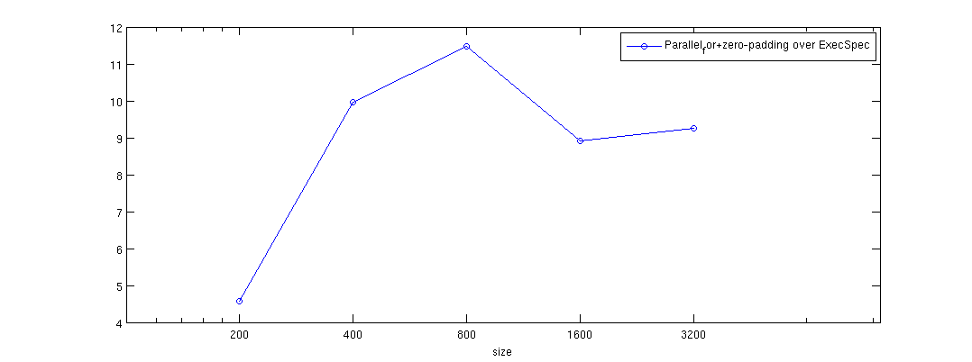
Non-Periodic heat
Performance on Cagnode9, 8 core machine,
Intel Xeon X5460@3.16GHz
Cache size: 6144 KB
GNU Linux 2.6.x, x86_64
Speedup of parallel_for + zero-padding over
raw ExecSpec

Slide 27
Can it go faster?
Pochoir<2> heat;
Pochoir_Array<double, 2> a(N_SIZE, M_SIZE);
Pochoir_Shape<2> shape[6] = {{0, 0, 0}, {-1, 1, 0}, {-1, 0, 0}, {-1, -1, 0}, {-1, 0, -1}, {-1, 0, 1}};
Pochoir_Boundary_2D(bdry, arr, t, i, j)
if (i <= 0 || i >= arr.size(1)-1 || j < =0 || j >= arr.size(0)-1)
return 0;
else
return arr.get(t, i, j);
Pochoir_Boundary_end
Pochoir_kernel_2D(kern, t, i, j)
a(t, i, j) = 0.125 * (a(t-1, i+1, j) - 2.0 * a(t-1, i, j) + a(t-1, i-1, j)) + 0.125 * (a(t-1, i, j+1) - 2.0 * a(t-1, i, j) + a(t-1, i, j-1)) + a(t-1, i, j);1)) + a(t-1, i, j);
Pochoir_kernel_end
for (int i = 0; i < N_SIZE; ++i) {
for (int j = 0; j < N_SIZE; ++j) {
a(0, i, j) = rand();
}}
heat.registerBoundaryFn(a, bdry);
heat.registerShape(shape);
heat.run(T, kern);

Slide 28
Minimize the boundary checking
t
x

Slide 29
Adaptive Cutting Strategy
Minimize the boundary region
t
x

Slide 30
Macro Trick
Pochoir<2> heat;
Pochoir_Array<double, 2> a(N_SIZE, M_SIZE);
Pochoir_Shape<2> shape[6] = {{1, 0, 0}, {0, 1, 0}, {0, -1, 0}, {0, 0, 0}, {0, 0, -1}, {0, 0, 1}}; Pochoir_Boundary_2D(bdry, arr, t, i, j)
if (i <= 0 || i >= arr.size(1)-1 || j < =0 || j >= arr.size(0)-1)
return 0;
else
return arr.get(t, i, j);
Pochoir_Boundary_end
Pochoir_kernel_2D(kern, t, i, j)
a(t, i, j) = 0.125 * (a(t-1, i+1, j) - 2.0 * a(t-1, i, j) + a(t-1, i-1, j)) + 0.125 * (a(t-1, i, j+1) - 2.0 * a(t-1, i, j) + a(t-1, i, j-1)) + a(t-1, i, j);1)) + a(t-1, i, j);
Pochoir_kernel_end
heat.registerBoundaryFn(a, bdry);
heat.registerArray(a);
heat.registerShape(shape);
heat.run(T, kern);
Pochoir<2> heat;
Pochoir_Array<double, 2> a(N_SIZE, M_SIZE);
Pochoir_Shape<2> shape[6] = {{0, 0, 0}, {-1, 1, 0}, {-1, 0, 0}, {-1, -1, 0}, {-1, 0, -1}, {-1, 0, 1}}; Pochoir_Boundary_2D(bdry, arr, t, i, j)
if (i <= 0 || i >= arr.size(1)-1 || j < =0 || j >= arr.size(0)-1)
return 0;
else
return arr.get(t, i, j);
Pochoir_Boundary_end
Pochoir_kernel_2D(kern, t, i, j)
a(t, i, j) = 0.125 * (a(t-1, i+1, j) - 2.0 * a(t-1, i, j) + a(t-1, i-1, j)) + 0.125 * (a(t-1, i, j+1) - 2.0 * a(t-1, i, j) + a(t-1, i, j-1)) + a(t-1, i, j);1)) + a(t-1, i, j);
Pochoir_kernel_end
heat.registerBoundaryFn(a, bdry);
heat.registerShape(shape);
{
#define a(t, i, j) a.interior(t, i, j)
Pochoir_kernel_2D(interior_kern, t, i, j)
a(t, i, j) = 0.125 * (a(t-1, i+1, j) - 2.0 * a(t-1, i, j) + a(t-1, i-1, j)) + 0.125 * (a(t-1, i, j+1) - 2.0 * a(t-1, i, j) + a(t-1, i, j-1)) + a(t-1, i, j);1)) + a(t-1, i, j);
Pochoir_kernel_end
#undef a(t, i, j)
heat.run(T, interior_kern, kern);
}

Slide 31
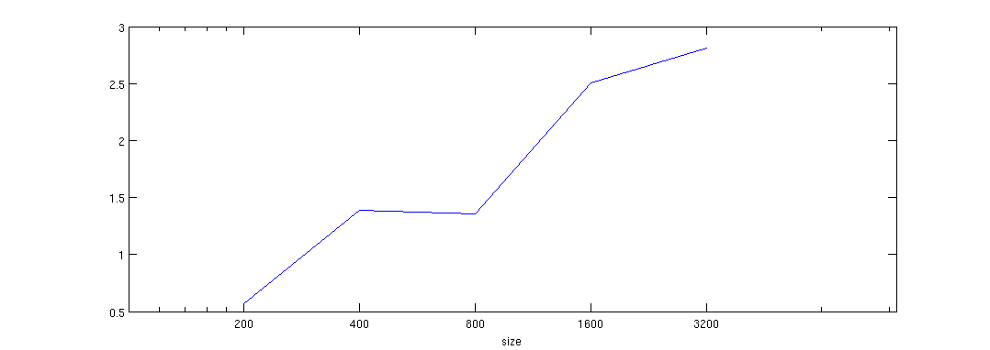
Non-Periodic heat
Performance on Cagnode9, 8 core machine,
Intel Xeon X5460@3.16GHz
Cache size: 6144 KB
GNU Linux 2.6.x, x86_64
Speedup of -split-macro-shadow over
parallel_for + zero padding

Slide 32
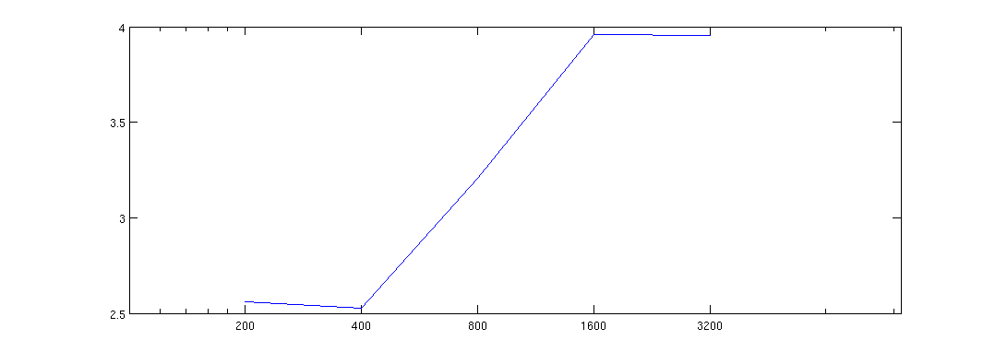
Periodic heat
Performance on Cagnode9, 8 core machine,
Intel Xeon X5460@3.16GHz
Cache size: 6144 KB
GNU Linux 2.6.x, x86_64
Speedup of -split-macro-shadow over
parallel_for

Slide 33
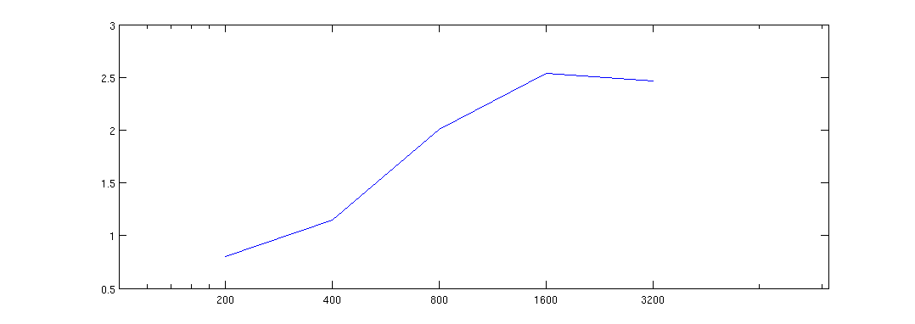
Periodic Game of Life
Performance on Cagnode9, 8 core machine,
Intel Xeon X5460@3.16GHz
Cache size: 6144 KB
GNU Linux 2.6.x, x86_64
Speedup of -split-macro-shadow over
parallel_for

Slide 34
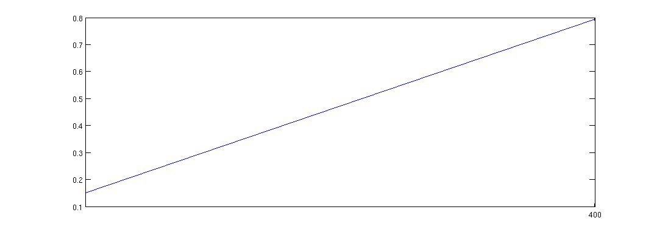
Non-Periodic 3dfd
Performance on Cagnode9, 8 core machine,
Intel Xeon X5460@3.16GHz
Cache size: 6144 KB
GNU Linux 2.6.x, x86_64
Speedup of -split-macro-shadow over
C-style pointer+parallel_for + zero padding

Slide 35
indexing issue
Pochoir<2> heat;
Pochoir_Array<double, 2> a(N_SIZE, M_SIZE);
Pochoir_Shape<2> shape[6] = {{0, 0, 0}, {-1, 1, 0}, {-1, 0, 0}, {-1, -1, 0}, {-1, 0, -1}, {-1, 0, 1}}; Pochoir_Boundary_2D(bdry, arr, t, i, j)
if (i <= 0 || i >= arr.size(1)-1 || j < =0 || j >= arr.size(0)-1)
return 0;
else
return arr.get(t, i_dom, j);
Pochoir_Boundary_end
Pochoir_kernel_2D(kern, t, i, j)
a(t, i, j) = 0.125 * (a(t-1, i+1, j) - 2.0 * a(t-1, i, j) + a(t-1, i-1, j)) + 0.125 * (a(t-1, i, j+1) - 2.0 * a(t-1, i, j) + a(t-1, i, j-1)) + a(t-1, i, j);1)) + a(t-1, i, j);
Pochoir_kernel_end
heat.registerBoundaryFn(a, bdry);
heat.registerShape(shape);
{
#define a(t, i, j) a.interior(t, i, j)
Pochoir_kernel_2D(interior_kern, t, i, j)
a(t, i, j) = 0.125 * (a(t-1, i+1, j) - 2.0 * a(t-1, i, j) + a(t-1, i-1, j)) + 0.125 * (a(t-1, i, j+1) - 2.0 * a(t-1, i, j) + a(t-1, i, j-1)) + a(t-1, i, j);1)) + a(t-1, i, j);
Pochoir_kernel_end
#undef a(t, i, j)
heat.run(T, interior_kern, kern);
}

Slide 36
indexing issue
Pochoir<2> heat;
Pochoir_Array<double, 2> a(N_SIZE, M_SIZE);
Pochoir_Shape<2> shape[6] = {{0, 0, 0}, {-1, 1, 0}, {-1, 0, 0}, {-1, -1, 0}, {-1, 0, -1}, {-1, 0, 1}}; Pochoir_Boundary_2D(bdry, arr, t, i, j)
if (i <= 0 || i >= arr.size(1)-1 || j < =0 || j >= arr.size(0)-1)
return 0;
else
return arr.get(t, i, j);
Pochoir_Boundary_end
Pochoir_kernel_2D(kern, t, i, j)
a(t, i, j) = 0.125 * (a(t-1, i+1, j) - 2.0 * a(t-1, i, j) + a(t-1, i-1, j)) + 0.125 * (a(t-1, i, j+1) - 2.0 * a(t-1, i, j) + a(t-1, i, j-1)) + a(t-1, i, j);1)) + a(t-1, i, j);
Pochoir_kernel_end
heat.registerBoundaryFn(a, bdry);
heat.registerShape(shape);
{
#define a(t, i, j) a.interior(t, i, j)
Pochoir_kernel_2D(interior_kern, t, i, j)
a(t, i, j) = 0.125 * (a(t-1, i+1, j) - 2.0 * a(t-1, i, j) + a(t-1, i-1, j)) + 0.125 * (a(t-1, i, j+1) - 2.0 * a(t-1, i, j) + a(t-1, i, j-1)) + a(t-1, i, j);1)) + a(t-1, i, j);
Pochoir_kernel_end
#undef a(t, i, j)
heat.run(T, interior_kern, kern);
}
for (int t = 0; t < T_SIZE; ++t) {
for (int i= 0; i < N_SIZE; ++i) {
for (int j = 0; j < N_SIZE; ++j) {
a[(t&1)*total_size + i * stride_i +
j*stride_j] = ….
}
}
}

Slide 37
indexing issue
Pochoir<2> heat;
Pochoir_Array<double, 2> a(N_SIZE, M_SIZE);
Pochoir_Shape<2> shape[6] = {{0, 0, 0}, {-1, 1, 0}, {-1, 0, 0}, {-1, -1, 0}, {-1, 0, -1}, {-1, 0, 1}}; Pochoir_Boundary_2D(bdry, arr, t, i, j)
if (i <= 0 || i >= arr.size(1)-1 || j < =0 || j >= arr.size(0)-1)
return 0;
else
return arr.get(t, i, j);
Pochoir_Boundary_end
Pochoir_kernel_2D(kern, t, i, j)
a(t, i, j) = 0.125 * (a(t-1, i+1, j) - 2.0 * a(t-1, i, j) + a(t-1, i-1, j)) + 0.125 * (a(t-1, i, j+1) - 2.0 * a(t-1, i, j) + a(t-1, i, j-1)) + a(t-1, i, j);1)) + a(t-1, i, j);
Pochoir_kernel_end
heat.registerBoundaryFn(a, bdry);
heat.registerShape(shape);
{
#define a(t, i, j) a.interior(t, i, j)
Pochoir_kernel_2D(interior_kern, t, i, j)
a(t, i, j) = 0.125 * (a(t-1, i+1, j) - 2.0 * a(t-1, i, j) + a(t-1, i-1, j)) + 0.125 * (a(t-1, i, j+1) - 2.0 * a(t-1, i, j) + a(t-1, i, j-1)) + a(t-1, i, j);1)) + a(t-1, i, j);
Pochoir_kernel_end
#undef a(t, i, j)
heat.run(T, interior_kern, kern);
}
for (int t = 0; t < T_SIZE; ++t) {
for (int i = 0; i < N_SIZE; ++i) {
for (int j = 0; j < N_SIZE; ++j) {
a[(t&1)*total_size + i * stride_i +
j*stride_j] = ….
}
}
}
for (int t = 0; t < T_SIZE; ++t) {
_t = (t&1) * total_size;
for (int i = 0; i < N_SIZE; ++i) {
_i = i * stride_i;
for (int j = 0; j < N_SIZE; ++j) {
_j = j * stride_j;
a[_t + _i + _j] = ….
}
}
}

Slide 38
Using Iterator to traverse internal sub-trapezoid
t
x

Slide 39
Base case optimized by iterator
Pochoir<2> heat;
Pochoir_Array<double, 2> a(N_SIZE, M_SIZE);
Pochoir_Shape<2> shape[6] = {{0, 0, 0}, {-1, 1, 0}, {-1, 0, 0}, {-1, -1, 0}, {-1, 0, -1}, {-1, 0, 1}}; Pochoir_Boundary_2D(bdry, arr, t, i, j)
if (i <= 0 || i >= arr.size(1)-1 || j < =0 || j >= arr.size(0)-1)
return 0;
else
return arr.get(t, i, j);
Pochoir_Boundary_end
Pochoir_kernel_2D(kern, t, i, j)
a(t, i, j) = 0.125 * (a(t-1, i+1, j) - 2.0 * a(t-1, i, j) + a(t-1, i-1, j)) + 0.125 * (a(t-1, i, j+1) - 2.0 * a(t-1, i, j) + a(t-1, i, j-1)) + a(t-1, i, j);1)) + a(t-1, i, j);
Pochoir_kernel_end
heat.registerBoundaryFn(a, bdry);
heat.registerShape(shape);
{
#define a(t, i, j) a.interior(t, i, j)
Pochoir_kernel_2D(interior_kern, t, i, j)
a(t, i, j) = 0.125 * (a(t-1, i+1, j) - 2.0 * a(t-1, i, j) + a(t-1, i-1, j)) + 0.125 * (a(t-1, i, j+1) - 2.0 * a(t-1, i, j) + a(t-1, i, j-1)) + a(t-1, i, j);1)) + a(t-1, i, j);
Pochoir_kernel_end
#undef a(t, i, j)
heat.run(T, interior_kern, kern);
}
Pochoir_kernel_2D(iter_kern, t, i_dom, j)
grid_info<2> l_grid = grid;
Pochoir_Iterator<double, 2> iter0(a); Pochoir_Iterator<double, 2> iter1(a);
Pochoir_Iterator<double, 2> iter2(a); Pochoir_Iterator<double, 2> iter3(a);
Pochoir_Iterator<double, 2> iter4(a); Pochoir_Iterator<double, 2> iter5(a);
int gap_a_1, gap_a_0;
const int l_stride_a_1 = a.stride(1), l_stride_a_0 = a.stride(0);
for (int t = t0; t < t1; ++t) {
iter0.set(t + 1, l_grid.x0[1], l_grid.x0[0]);
iter1.set(t, l_grid.x0[1] + 1, l_grid.x0[0]);
iter2.set(t, l_grid.x0[1], l_grid.x0[0]);
iter3.set(t, l_grid.x0[1] - 1, l_grid.x0[0]);
iter4.set(t, l_grid.x0[1], l_grid.x0[0] + 1);
iter5.set(t, l_grid.x0[1], l_grid.x0[0] - 1);
gap_a_1 = l_stride_a_1 + (l_grid.x0[0] - l_grid.x1[0]) * l_stride_a_0;
for (int i = l_grid.x0[1]; i < l_grid.x1[1]; ++i, iter0.inc(gap_a_1), iter1.inc(gap_a_1), iter2.inc(gap_a_1), iter3.inc(gap_a_1), iter4.inc(gap_a_1), iter5.inc(gap_a_1)) {
for (int j = l_grid.x0[0]; j < l_grid.x1[0]; ++j, ++iter0, ++iter1, ++iter2, ++iter3, ++iter4, ++iter5) {
iter0 = 0.125 * (iter1 - 2.0 * iter2 + iter3) + 0.125 * (iter4 - 2.0 * iter2 + iter5) + iter2;
} } /* end for (sub-trapezoid) */
/* Adjust sub-trapezoid! */
for (int i = 0; i < 2; ++i) {
l_grid.x0[i] += l_grid.dx0[i]; l_grid.x1[i] += l_grid.dx1[i];
}
} /* end for t */
Pochoir_kernel_end
heat.run_obase(T_SIZE, obase_kern, kern);
}
One iterator for one shape item

Slide 40
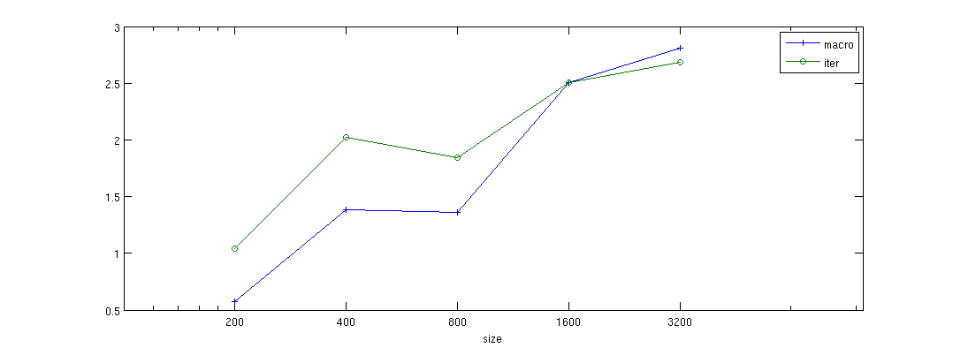
Non-Periodic heat
Performance on Cagnode9, 8 core machine,
Intel Xeon X5460@3.16GHz
Cache size: 6144 KB
GNU Linux 2.6.x, x86_64
Speedup of -split-iter over parallel_for
, –split-macro-shadow over parallel_for

Slide 41
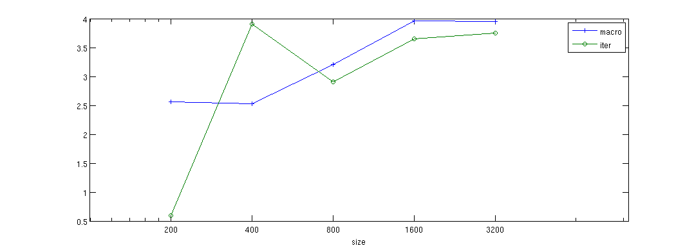
Periodic heat
Performance on Cagnode9, 8 core machine,
Intel Xeon X5460@3.16GHz
Cache size: 6144 KB
GNU Linux 2.6.x, x86_64
Speedup of -split-iter over parallel_for
, speedup of –split-macro-shadow over
parallel_for

Slide 42
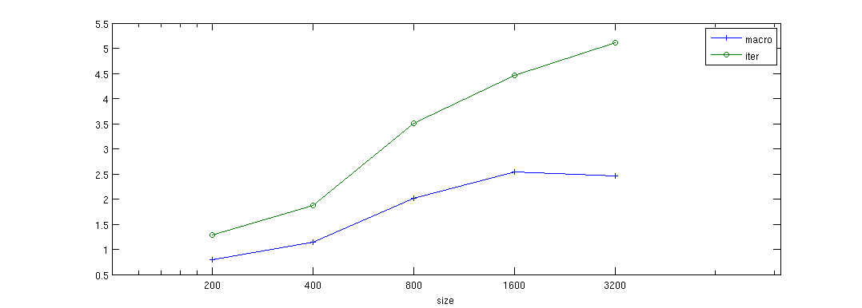
Periodic Game of Life
Performance on Cagnode9, 8 core machine,
Intel Xeon X5460@3.16GHz
Cache size: 6144 KB
GNU Linux 2.6.x, x86_64
Speedup of –split-iter over parallel_for
, speedup of –split-macro-shadow over
Parallel_for

Slide 43
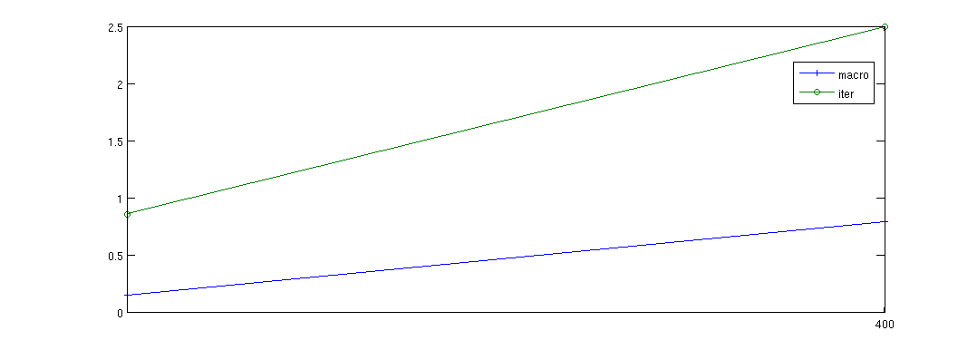
Non-Periodic 3dfd
Performance on Cagnode9, 8 core machine,
Intel Xeon X5460@3.16GHz
Cache size: 6144 KB
GNU Linux 2.6.x, x86_64
Speedup of -split-iter over parallel_for
, speedup of –split-macro-shadow over
parallel_for

Slide 44
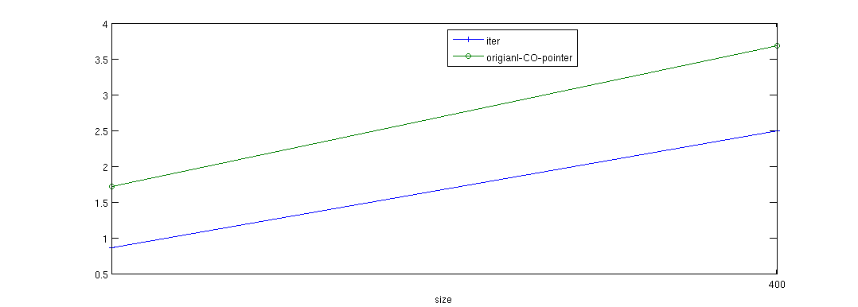
Performance bug revealed by 3dfd
Performance on Cagnode9, 8 core machine,
Intel Xeon X5460@3.16GHz
Cache size: 6144 KB
GNU Linux 2.6.x, x86_64
Speedup of -split-iter over parallel_for
versus original CO in 3dfd (C-style pointer)

Slide 45
problems in iterator
Pochoir<2> heat;
Pochoir_Array<double, 2> a(N_SIZE, M_SIZE);
Pochoir_Shape<2> shape[6] = {{1, 0, 0}, {0, 1, 0}, {0, -1, 0}, {0, 0, -1}, {0, 0, 1}};
Pochoir_Boundary_2D(bdry, arr, t, i, j)
if (i <= 0 || i >= arr.size(1)-1 || j < =0 || j >= arr.size(0)-1)
return 0;
else
return arr.get(t, i, j);
Pochoir_Boundary_end
Pochoir_kernel_2D(kern, t, i, j)
a(t, i, j) = 0.125 * (a(t-1, i+1, j) - 2.0 * a(t-1, i, j) + a(t-1, i-1, j)) + 0.125 * (a(t-1, i, j+1) - 2.0 * a(t-1, i, j) + a(t-1, i, j-1)) + a(t-1, i, j);1)) + a(t-1, i, j);
Pochoir_kernel_end
heat.registerBoundaryFn(a, bdry);
heat.registerShape(shape);
heat.run(T, kern);
Pochoir_kernel_2D(iter_kern, t, i_dom, j)
grid_info<2> l_grid = grid;
Pochoir_Iterator<double, 2> iter0(a); Pochoir_Iterator<double, 2> iter1(a);
Pochoir_Iterator<double, 2> iter2(a); Pochoir_Iterator<double, 2> iter3(a);
Pochoir_Iterator<double, 2> iter4(a); Pochoir_Iterator<double, 2> iter5(a);
int gap_a_1, gap_a_0;
const int l_stride_a_1 = a.stride(1), l_stride_a_0 = a.stride(0);
for (int t = t0; t < t1; ++t) {
iter0.set(t + 1, l_grid.x0[1], l_grid.x0[0]);
iter1.set(t, l_grid.x0[1] + 1, l_grid.x0[0]);
iter2.set(t, l_grid.x0[1], l_grid.x0[0]);
iter3.set(t, l_grid.x0[1] - 1, l_grid.x0[0]);
iter4.set(t, l_grid.x0[1], l_grid.x0[0] + 1);
iter5.set(t, l_grid.x0[1], l_grid.x0[0] - 1);
gap_a_1 = l_stride_a_1 + (l_grid.x0[0] - l_grid.x1[0]) * l_stride_a_0;
for (int i = l_grid.x0[1]; i < l_grid.x1[1]; ++i, iter0.inc(gap_a_1), iter1.inc(gap_a_1), iter2.inc(gap_a_1), iter3.inc(gap_a_1), iter4.inc(gap_a_1), iter5.inc(gap_a_1)) {
for (int j = l_grid.x0[0]; j < l_grid.x1[0]; ++j, ++iter0, ++iter1, ++iter2, ++iter3, ++iter4, ++iter5) {
iter0 = 0.125 * (iter1 - 2.0 * iter2 + iter3) + 0.125 * (iter4 - 2.0 * iter2 + iter5) + iter2;
} } /* end for (sub-trapezoid) */
/* Adjust sub-trapezoid! */
for (int i = 0; i < 2; ++i) {
l_grid.x0[i] += l_grid.dx0[i]; l_grid.x1[i] += l_grid.dx1[i];
}
} /* end for t */
Pochoir_kernel_end
heat.run_obase(T_SIZE, obase_kern, kern);
}

Slide 46
From iterator to pointer
Pochoir_kernel_2D(iter_kern, t, i_dom, j)
grid_info<2> l_grid = grid;
Pochoir_Iterator<double, 2> iter0(a); Pochoir_Iterator<double, 2> iter1(a);
Pochoir_Iterator<double, 2> iter2(a); Pochoir_Iterator<double, 2> iter3(a);
Pochoir_Iterator<double, 2> iter4(a); Pochoir_Iterator<double, 2> iter5(a);
int gap_a_1, gap_a_0;
const int l_stride_a_1 = a.stride(1), l_stride_a_0 = a.stride(0);
for (int t = t0; t < t1; ++t) {
iter0.set(t + 1, l_grid.x0[1], l_grid.x0[0]);
iter1.set(t, l_grid.x0[1] + 1, l_grid.x0[0]);
iter2.set(t, l_grid.x0[1], l_grid.x0[0]);
iter3.set(t, l_grid.x0[1] - 1, l_grid.x0[0]);
iter4.set(t, l_grid.x0[1], l_grid.x0[0] + 1);
iter5.set(t, l_grid.x0[1], l_grid.x0[0] - 1);
gap_a_1 = l_stride_a_1 + (l_grid.x0[0] - l_grid.x1[0]) * l_stride_a_0;
for (int i = l_grid.x0[1]; i < l_grid.x1[1]; ++i, iter0.inc(gap_a_1), iter1.inc(gap_a_1), iter2.inc(gap_a_1), iter3.inc(gap_a_1), iter4.inc(gap_a_1), iter5.inc(gap_a_1)) {
for (int j = l_grid.x0[0]; j < l_grid.x1[0]; ++j, ++iter0, ++iter1, ++iter2, ++iter3, ++iter4, ++iter5) {
iter0 = 0.125 * (iter1 - 2.0 * iter2 + iter3) + 0.125 * (iter4 - 2.0 * iter2 + iter5) + iter2;
} } /* end for (sub-trapezoid) */
/* Adjust sub-trapezoid! */
for (int i = 0; i < 2; ++i) {
l_grid.x0[i] += l_grid.dx0[i]; l_grid.x1[i] += l_grid.dx1[i];
}
} /* end for t */
Pochoir_kernel_end
heat.run_obase(T_SIZE, obase_kern, kern);
}
Pochoir_kernel_2D(pointer_kern, t, i_dom, j)
grid_info<2> l_grid = grid;
double * pt_a_1; double * pt_a_0;
double * a_base = a.data();
const int l_a_total_size = a.total_size();
int gap_a_1, gap_a_0;
const int l_stride_a_1 = a.stride(1), l_stride_a_0 = a.stride(0);
for (int t = t0; t < t1; ++t) {
pt_a_0 = a_base + ((t + 1) & 1) * l_a_total_size + l_grid.x0[1] * l_stride_a_1 + l_grid.x0[0] * l_stride_a_0;
pt_a_1 = a_base + ((t) & 1) * l_a_total_size + l_grid.x0[1] * l_stride_a_1 + l_grid.x0[0] * l_stride_a_0;
gap_a_1 = l_stride_a_1 + (l_grid.x0[0] - l_grid.x1[0]) * l_stride_a_0;
for (int i = l_grid.x0[1]; i < l_grid.x1[1]; ++i, pt_a_0 += gap_a_1, pt_a_1 += gap_a_1) {
#pragma ivdep
for (int j = l_grid.x0[0]; j < l_grid.x1[0]; ++j, ++pt_a_0, ++pt_a_1) {
pt_a_0[0] = 0.125 * (pt_a_1[l_stride_a_1 * (1)] - 2.0 * pt_a_1[0] + pt_a_1[l_stride_a_1 * (-1)]) + 0.125 * (pt_a_1[l_stride_a_0 * (1)] - 2.0 * pt_a_1[0] + pt_a_1[l_stride_a_0 * (-1)]) + pt_a_1[0];
} } /* end for (sub-trapezoid) */
/* Adjust sub-trapezoid! */
for (int i = 0; i < 2; ++i) {
l_grid.x0[i] += l_grid.dx0[i]; l_grid.x1[i] += l_grid.dx1[i];
}
} /* end for t */
Pochoir_kernel_end
heat.run_obase(T_SIZE, pointer_kern, kern);
}

Slide 47
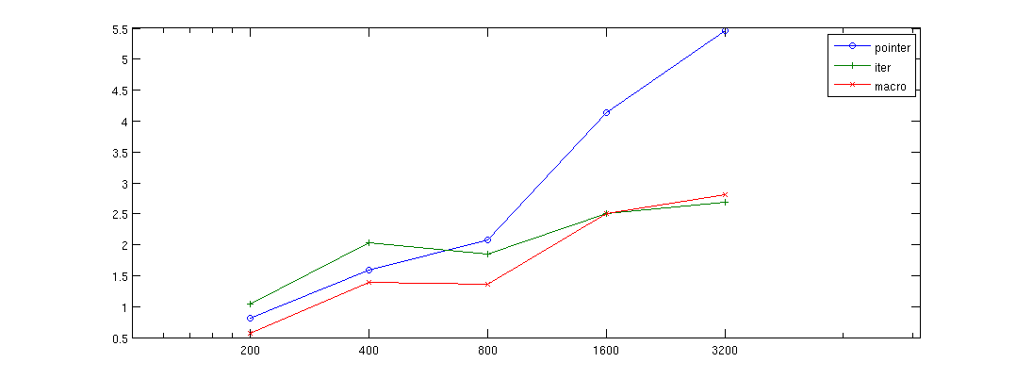
Non-Periodic heat
Performance on Cagnode9, 8 core machine,
Intel Xeon X5460@3.16GHz
Cache size: 6144 KB
GNU Linux 2.6.x, x86_64
Speedup of -split-pointer over parallel_for
-split-iter over parallel_for
-split-macro-shadow over parallel_for

Slide 48
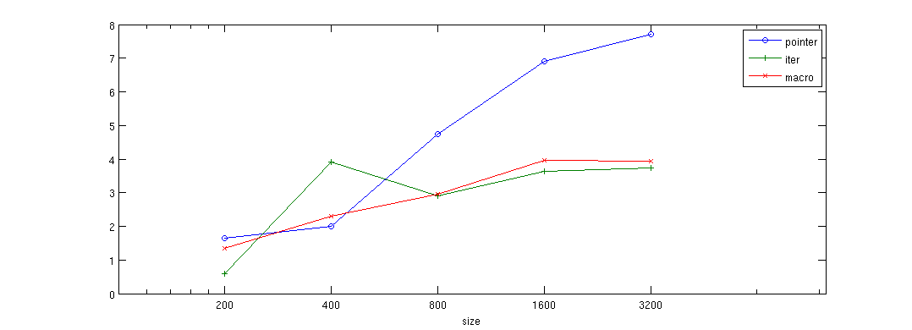
Periodic heat
Performance on Cagnode9, 8 core machine,
Intel Xeon X5460@3.16GHz
Cache size: 6144 KB
GNU Linux 2.6.x, x86_64
Speedup of -split-pointer over parallel_for
-split-iter over parallel_for
-split-macro-shadow over parallel_for

Slide 49
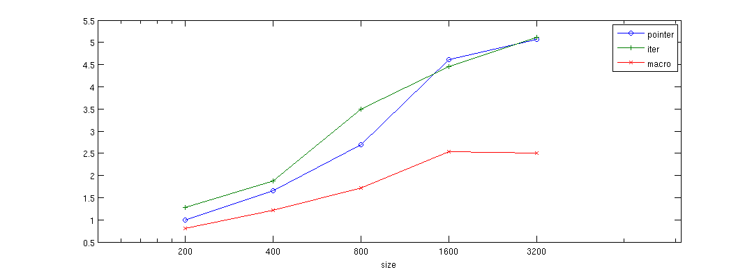
Periodic Game of Life
Performance on Cagnode9, 8 core machine,
Intel Xeon X5460@3.16GHz
Cache size: 6144 KB
GNU Linux 2.6.x, x86_64
Speedup of -split-pointer over parallel_for
-split-iter over parallel_for
-split-macro-shadow over parallel_for

Slide 50
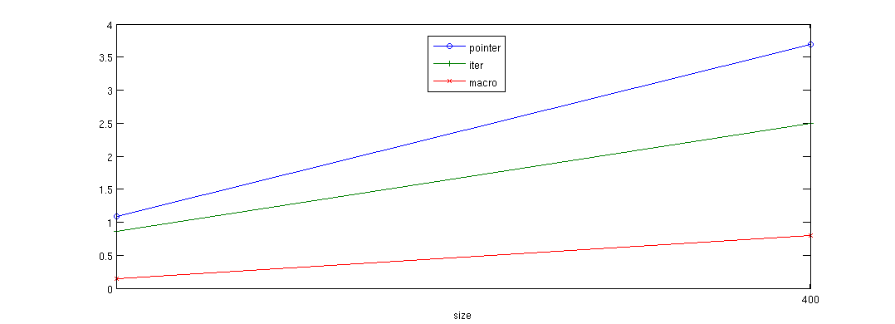
Non-Periodic 3dfd
Performance on Cagnode9, 8 core machine,
Intel Xeon X5460@3.16GHz
Cache size: 6144 KB
GNU Linux 2.6.x, x86_64
Speedup of -split-pointer over parallel_for
-split-iter over parallel_for
-split-macro-shadow over parallel_for

Slide 51
Conclusion
Executable Spec. version 1.0 ready to go
P = NP
Different optimization level shows up very different performance behavior
Cache oblivious algorithm is really cache insensitive and loop-based (serial version) is very cache sensitive
Boundary checking and handling is still a significant overhead although minimized.

Slide 52
Known Problem
In Pochoir, we specify boundary condition by an arbitrary C++ function
Pros: Flexible, Unifying the P and NP
Cons: Too much power
e.g. wire up edge directly to the middle
Type theory comes to the rescue
For a given type, only such set of operations are allowed, otherwise, a compile-time error
Proposed solution:
Make the indices variable of a new type ‘dim’ in boundary function
Restrict the way that user can manipulate the indices of Pochoir_Array
Only certain operations are allowed on type ‘dim’.
Avoid arbitrary manipulation of indices and Pochoir_Array inside boundary function
Notes:
Potential operations on Dim variable
Non-Periodic: return value, return func /* assuming func is NOT an alias of any Pochoir_Array */
Periodic: normal modulo operation, change_direction /* array_size – i */.
Switch some dim variables, such as arr.get(j, i);

Slide 53
Potential (Allowable) operations on type ‘dim’
Non-Periodic Stencil
return value
return func /* assuming func is NOT an alias of any Pochoir_Array */
Periodic Stencil
Normal modulo operation
change_direction /* array_size – i */
Abnormal Stencil
Switch some dim variables
e.g. arr.get(j, i)
Notes:
Potential operations on Dim variable
Non-Periodic: return value, return func /* assuming func is NOT an alias of any Pochoir_Array */
Periodic: normal modulo operation, change_direction /* array_size – i */.
Switch some dim variables, such as arr.get(j, i);

Slide 54

Example boundaries - cyclinder
Notes:
Potential operations on Dim variable
Non-Periodic: return value, return func /* assuming func is NOT an alias of any Pochoir_Array */
Periodic: normal modulo operation, change_direction /* array_size – i */.
Switch some dim variables, such as arr.get(j, i);

Slide 55
Example boundaries - cylinder
Pochoir_Boundary_2D(bdry, arr, t, i, j)
dim<1> new_i = i;
dim<0> new_j = j;
/* dim 1 is non-periodic */
if (! pochoir_inside_domain(new_i, arr))
return 0;
/* dim 0 is periodic */
new_j = pochoir_mod(arr, new_j);
return arr.get(t, new_i, new_j);
Pochoir_Boundary_end
Notes:
Potential operations on Dim variable
Non-Periodic: return value, return func /* assuming func is NOT an alias of any Pochoir_Array */
Periodic: normal modulo operation, change_direction /* array_size – i */.
Switch some dim variables, such as arr.get(j, i);

Slide 56
Example boundaries - cylinder
Pochoir_Boundary_2D(bdry, arr, t, i, j)
dim<1> new_i = i;
dim<0> new_j = j;
/* dim 1 is non-periodic */
if (! pochoir_inside_domain(new_i, arr))
return 0;
/* dim 0 is periodic */
new_j = pochoir_mod(arr, new_j);
return arr.get(t, new_i, new_j);
Pochoir_Boundary_end
Declare two variables of type dim<rank>
rank is the rank of spatial dimension
Notes:
Potential operations on Dim variable
Non-Periodic: return value, return func /* assuming func is NOT an alias of any Pochoir_Array */
Periodic: normal modulo operation, change_direction /* array_size – i */.
Switch some dim variables, such as arr.get(j, i);

Slide 57
Example boundaries - cylinder
Pochoir_Boundary_2D(bdry, arr, t, i, j)
dim<1> new_i = i;
dim<0> new_j = j;
/* dim 1 is non-periodic */
if (! pochoir_inside_domain(new_i, arr))
return 0;
/* dim 0 is periodic */
new_j = pochoir_mod(arr, new_j);
return arr.get(t, new_i, new_j);
Pochoir_Boundary_end
dim<1>: new_i is non-periodic;
Notes:
Potential operations on Dim variable
Non-Periodic: return value, return func /* assuming func is NOT an alias of any Pochoir_Array */
Periodic: normal modulo operation, change_direction /* array_size – i */.
Switch some dim variables, such as arr.get(j, i);

Slide 58
Example boundaries - cylinder
Pochoir_Boundary_2D(bdry, arr, t, i, j)
dim<1> new_i = i;
dim<0> new_j = j;
/* dim 1 is non-periodic */
if (! pochoir_inside_domain(new_i, arr))
return 0;
/* dim 0 is periodic */
new_j = pochoir_mod(arr, new_j);
return arr.get(t, new_i, new_j);
Pochoir_Boundary_end
dim<0>: new_j is non-periodic;
Notes:
Potential operations on Dim variable
Non-Periodic: return value, return func /* assuming func is NOT an alias of any Pochoir_Array */
Periodic: normal modulo operation, change_direction /* array_size – i */.
Switch some dim variables, such as arr.get(j, i);

Slide 59
Example boundaries - cylinder
Pochoir_Boundary_2D(bdry, arr, t, i, j)
dim<1> new_i = i;
dim<0> new_j = j;
/* dim 1 is non-periodic */
if (! pochoir_inside_domain(new_i, arr))
return 0;
/* dim 0 is periodic */
new_j = pochoir_mod(arr, new_j);
return arr.get(t, new_i, new_j);
Pochoir_Boundary_end
return the value at new location
(t, new_i, new_j)
Notes:
Potential operations on Dim variable
Non-Periodic: return value, return func /* assuming func is NOT an alias of any Pochoir_Array */
Periodic: normal modulo operation, change_direction /* array_size – i */.
Switch some dim variables, such as arr.get(j, i);

Slide 60
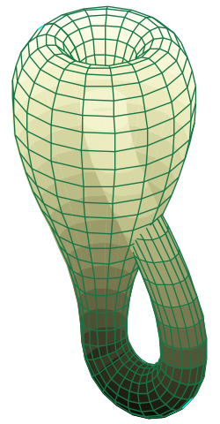
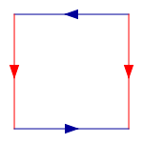
Example boundaries – Klein Bottle
Notes:
Potential operations on Dim variable
Non-Periodic: return value, return func /* assuming func is NOT an alias of any Pochoir_Array */
Periodic: normal modulo operation, change_direction /* array_size – i */.
Switch some dim variables, such as arr.get(j, i);

Slide 61
Example boundaries – Klein Bottle
Pochoir_Boundary_2D(bdry, arr, t, i, j)
dim<1> new_i = i;
dim<0> new_j = j;
new_i = pochoir_mod(arr, new_i);
if (!pochoir_inside_domain(new_j, arr) {
new_j = pochoir_mod(arr, new_j);
new_i = pochoir_change_direction(new_i);
}
return arr.get(t, new_i, new_j);
Pochoir_Boundary_end
Notes:
Potential operations on Dim variable
Non-Periodic: return value, return func /* assuming func is NOT an alias of any Pochoir_Array */
Periodic: normal modulo operation, change_direction /* array_size – i */.
Switch some dim variables, such as arr.get(j, i);

Slide 62
Example boundaries – Klein Bottle
Pochoir_Boundary_2D(bdry, arr, t, i, j)
dim<1> new_i = i;
dim<0> new_j = j;
new_i = pochoir_mod(arr, new_i);
if (!pochoir_inside_domain(new_j, arr) {
new_j = pochoir_mod(arr, new_j);
new_i = pochoir_change_direction(new_i);
}
return arr.get(t, new_i, new_j);
Pochoir_Boundary_end
Declare two variables of type dim<rank>
rank is the rank of spatial dimension
Notes:
Potential operations on Dim variable
Non-Periodic: return value, return func /* assuming func is NOT an alias of any Pochoir_Array */
Periodic: normal modulo operation, change_direction /* array_size – i */.
Switch some dim variables, such as arr.get(j, i);

Slide 63
Example boundaries – Klein Bottle
Pochoir_Boundary_2D(bdry, arr, t, i, j)
dim<1> new_i = i;
dim<0> new_j = j;
new_i = pochoir_mod(arr, new_i);
if (!pochoir_inside_domain(new_j, arr) {
new_j = pochoir_mod(arr, new_j);
new_i = pochoir_change_direction(new_i);
}
return arr.get(t, new_i, new_j);
Pochoir_Boundary_end
dim<1>: new_i is periodic;
Notes:
Potential operations on Dim variable
Non-Periodic: return value, return func /* assuming func is NOT an alias of any Pochoir_Array */
Periodic: normal modulo operation, change_direction /* array_size – i */.
Switch some dim variables, such as arr.get(j, i);

Slide 64
Example boundaries – Klein Bottle
Pochoir_Boundary_2D(bdry, arr, t, i, j)
dim<1> new_i = i;
dim<0> new_j = j;
new_i = pochoir_mod(arr, new_i);
if (!pochoir_inside_domain(new_j, arr) {
new_j = pochoir_mod(arr, new_j);
new_i = pochoir_change_direction(new_i);
}
return arr.get(t, new_i, new_j);
Pochoir_Boundary_end
dim<0>: new_j is reverse-periodic;
Notes:
Potential operations on Dim variable
Non-Periodic: return value, return func /* assuming func is NOT an alias of any Pochoir_Array */
Periodic: normal modulo operation, change_direction /* array_size – i */.
Switch some dim variables, such as arr.get(j, i);

Slide 65
Example boundaries – Klein Bottle
Pochoir_Boundary_2D(bdry, arr, t, i, j)
dim<1> new_i = i;
dim<0> new_j = j;
new_i = pochoir_mod(arr, new_i);
if (!pochoir_inside_domain(new_j, arr) {
new_j = pochoir_mod(arr, new_j);
new_i = pochoir_change_direction(new_i);
}
return arr.get(t, new_i, new_j);
Pochoir_Boundary_end
return the value at new location
(t, new_i, new_j)
Notes:
Potential operations on Dim variable
Non-Periodic: return value, return func /* assuming func is NOT an alias of any Pochoir_Array */
Periodic: normal modulo operation, change_direction /* array_size – i */.
Switch some dim variables, such as arr.get(j, i);

Slide 66
More performance numbers

Slide 67
Non-Periodic heat
Performance on Cagnode9, 8 core machine,
Intel Xeon X5460@3.16GHz
Cache size: 6144 KB
GNU Linux 2.6.x, x86_64

Slide 68
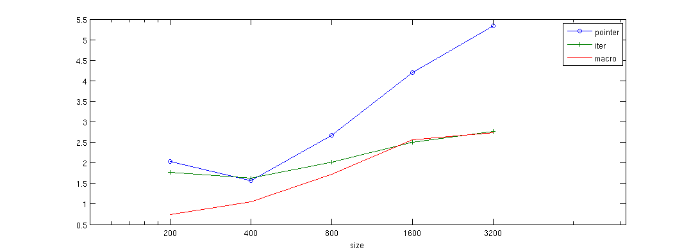
Non-Periodic heat
Performance on Cagnode17, 16 core machine,
Intel Xeon E7340@2.40GHz
Cache size: 4096 KB
GNU Linux 2.6.x, x86_64

Slide 69
Periodic heat
Performance on Cagnode9, 8 core machine,
Intel Xeon X5460@3.16GHz
Cache size: 6144 KB
GNU Linux 2.6.x, x86_64

Slide 70
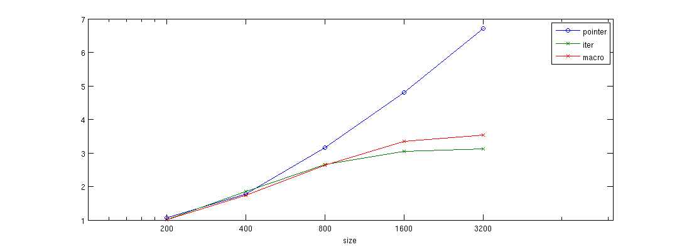
Periodic heat
Performance on Cagnode17, 16 core machine,
Intel Xeon E7340@2.40GHz
Cache size: 4096 KB
GNU Linux 2.6.x, x86_64

Slide 71
Periodic Game of Life
Performance on Cagnode9, 8 core machine,
Intel Xeon X5460@3.16GHz
Cache size: 6144 KB
GNU Linux 2.6.x, x86_64

Slide 72
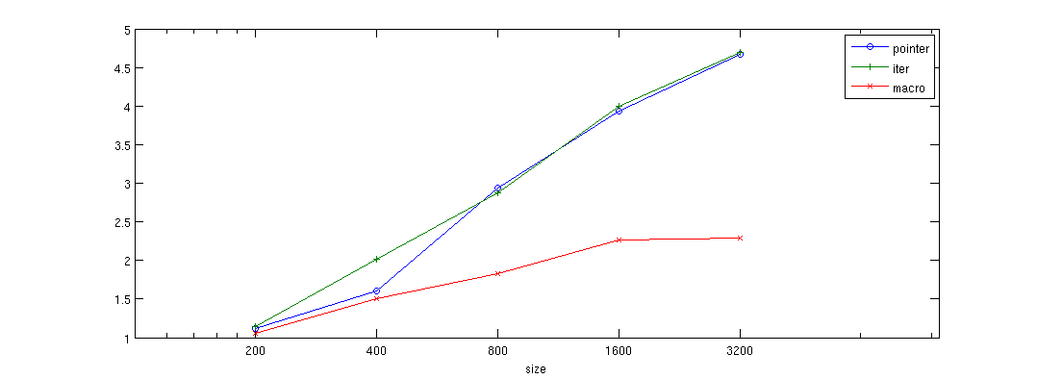
Periodic Game of Life
Performance on Cagnode17, 16 core machine,
Intel Xeon E7340@2.40GHz
Cache size: 4096 KB
GNU Linux 2.6.x, x86_64

Slide 73
Non-Periodic 3dfd
Performance on Cagnode9, 8 core machine,
Intel Xeon X5460@3.16GHz
Cache size: 6144 KB
GNU Linux 2.6.x, x86_64

Slide 74
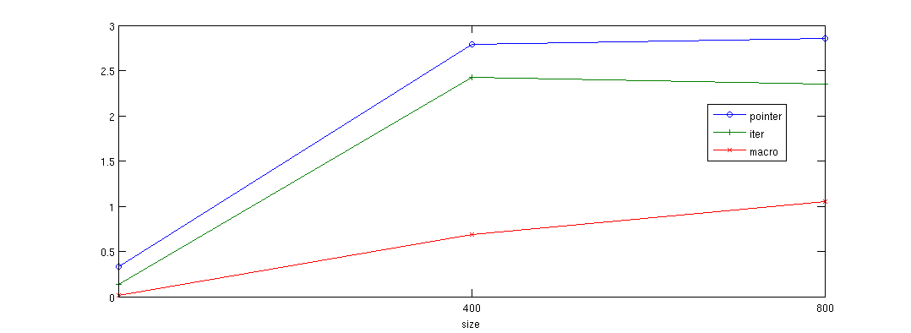
Non-Periodic 3dfd
Performance on Cagnode17, 16 core machine,
Intel Xeon E7340@2.40GHz
Cache size: 4096 KB
GNU Linux 2.6.x, x86_64

Slide 75
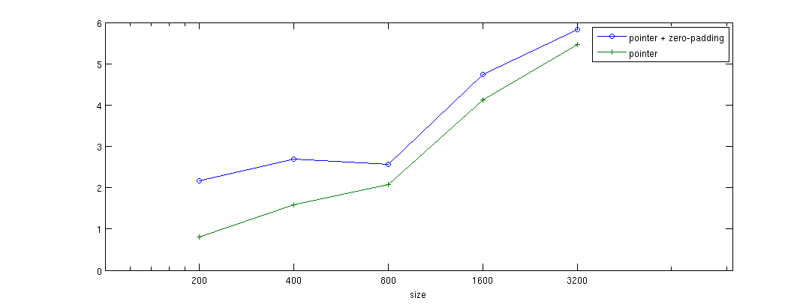
Non-Periodic heat
Performance on Cagnode9, 8 core machine,
Intel Xeon X5460@3.16GHz
Cache size: 6144 KB
GNU Linux 2.6.x, x86_64

Slide 76
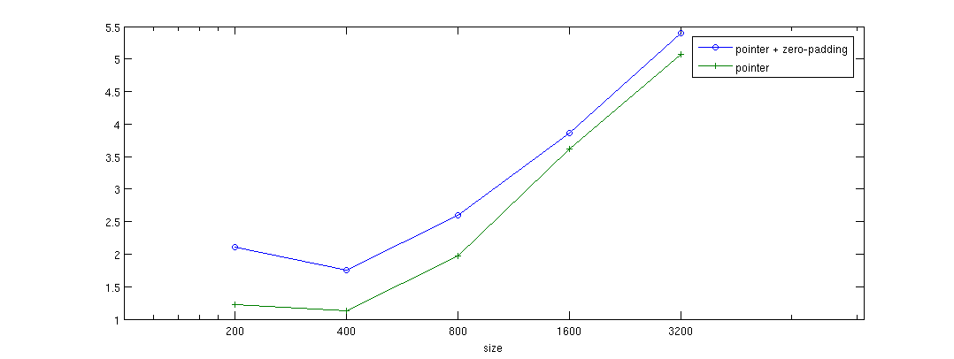
Non-Periodic heat
Performance on Cagnode17, 16 core machine,
Intel Xeon E7340@2.40GHz
Cache size: 4096 KB
GNU Linux 2.6.x, x86_64

